Slide 1


Slide 2

TRAINING AND DEVELOPMENT
Notes:
The incidence of both lower incomes due to economic crisis and persistent high food prices has proved to be a devastating combination for the world’s most vulnerable populations.

Slide 3
Orienting Employees
Employee orientation
  A procedure for providing new employees with basic background information about the firm.
Orientation content
  Information on employee benefits
  Personnel (HR) policies
  The daily routine
  Company organization and operations
  Safety measures and regulations
  Facilities tour

Slide 4
Orienting Employees (cont’d)
A successful orientation should accomplish four things for new employees:
  Make them feel welcome and at ease (homelike).
  Help them understand the organization in a broad sense.
  Make clear to them what is expected in terms of work and behavior.
  Help them begin the process of becoming socialized into the firm’s ways of acting and doing things (including prevailing culture).

Slide 5
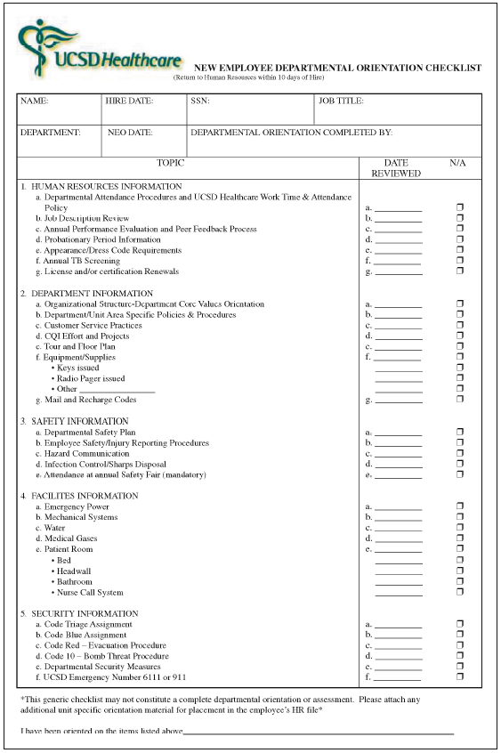
New Employee Departmental Orientation Checklist

Slide 6
The Training Process
Training
  The process of teaching new employees the basic skills they need to perform their jobs.
The strategic context of training
  Performance management: the process employers use to make sure employees are working toward organizational goals.
    Web-based training
    Distance learning-based training
    Cross-cultural diversity training

Slide 7
The Training and Development Process
Needs analysis
  Identify job performance skills needed, assess prospective trainees skills, and develop objectives.
Instructional design
  Produce the training program content, including workbooks, exercises, and activities.
Validation
  Presenting (trying out) the training to a small representative audience (also called pilot testing)
Implement the program
  Actually training the targeted employee group.
Evaluation
  Assesses the program’s successes or failures.

Slide 8
Make the Learning Meaningful
At the start of training, provide a bird’s-eye view of the material to be presented to facilitates learning.
Use a variety of familiar examples.
Organize the information so you can present it logically, and in meaningful units.
Use terms and concepts that are already familiar to trainees.
Use as many visual aids as possible.

Slide 9
Make Skills Transfer Easy
Maximize the similarity between the training situation and the work situation.
Provide adequate practice.
Label or identify each feature of the machine and/ or step in the process.
Direct trainees’ attention to important aspects of the job.
Provide “heads-up” preparatory information that lets trainees know they might happen back on the job.

Slide 10
Motivate the Learner
People learn best by doing so provide as much realistic practice as possible.
Trainees learn best when the trainers immediately reinforce correct responses
Trainees learn best at their own pace.
Create a perceived training need in the trainees’ minds.
The schedule is important too: The learning curve goes down late in the day, less than full day training is most effective.

Slide 11
Analyzing Training Needs
Task analysis
  A detailed study of a job to identify the specific skills required, especially for new employees.
Performance analysis
  Verifying that there is a performance deficiency and determining whether that deficiency should be corrected through training or through some other means (such as transferring the employee).

Slide 12
Training Methods
On-the-job training (OJT)
  Having a person learn a job by actually doing the job.
Apprenticeship training
  A structured process by which people become skilled workers through a combination of classroom instruction and on-the-job training.
Informal learning
  The majority of what employees learn on the job they learn through informal means of performing their jobs on a daily basis.
Job instruction training (JIT)
  Listing each job’s basic tasks, along with key points, in order to provide step-by-step training for employees.

Slide 13
Training Methods (cont’d)
Effective lectures
  Use signals to help listeners follow your ideas.
  Don’t start out on the wrong foot.
  Keep your conclusions short.
  Be alert to your audience.
  Maintain eye contact with the trainees.
  Make sure everyone in the room can hear.
  Control your hands.
  Talk from notes rather than from a script.
  Break a long talk into a series of five-minute talks.

Slide 14
Training Methods (cont’d)
Literacy training techniques
  Responses to functional illiteracy
    Testing job candidates’ basic skills.
    Setting up basic skills and literacy programs.
Audiovisual-based training
  To illustrate following a sequence over time.
  To expose trainees to events not easily demonstrable in live lectures.
  To meet the need for organization-wide training and it is too costly to move the trainers from place to place.

Slide 15
Training Methods (cont’d)
Simulated training (occasionally called vestibule training)
  Training employees on special off-the-job equipment so training costs and hazards can be reduced.
  Computer-based training (CBT)
  Electronic performance support systems (EPSS) – use of computerized tools & displays to automate training, documentation & phone support.
  Learning portals – using online vendors who make training material/lectures available via employer’s intranet portal.

Slide 16
Distance and Internet-Based Training
Teletraining
  A trainer in a central location teaches groups of employees at remote locations via TV hookups.
Videoconferencing
  Interactively training employees who are geographically separated from each other—or from the trainer—via a combination of audio and visual equipment.
Training via the Internet
  Using the Internet or proprietary internal intranets to facilitate computer-based training.

Slide 17
What Is Management Development?
Management development
  Any attempt to improve current or future management performance by imparting knowledge, changing attitudes, or increasing skills.
Succession planning
  A process through which senior-level openings are planned for and eventually filled.
    Anticipate management needs
    Review firm’s management skills inventory
    Create replacement charts
    Begin management development

Slide 18
Managerial on-the-Job Training
Job rotation
  Moving a trainee from department to department to broaden his or her experience and identify strong and weak points.
Coaching/Understudy approach
  The trainee works directly with a senior manager or with the person he or she is to replace; the latter is responsible for the trainee’s coaching.
Action learning
  Management trainees are allowed to work full-time analyzing and solving problems in different/ other departments.

Slide 19
Off-the-Job Management Training and Development Techniques
Case study method
  Managers are presented with a description of an organizational problem to diagnose and solve.
Management game
  Teams of managers compete by making computerized decisions regarding realistic but simulated situations.
Outside seminars
  Many companies and universities offer Web-based and traditional management development seminars and conferences.

Slide 20
Off-the-Job Management Training and Development Techniques (cont’d)
Role playing
  Creating a realistic situation in which trainees assume the roles of persons in that situation.
Behavior modeling
  Modeling: showing trainees the right (or “model”) way of doing something.
  Role playing: having trainees practice that way
  Social reinforcement: giving feedback on the trainees’ performance.
  Transfer of learning: Encouraging trainees apply their skills on the job.

Slide 21
Off-the-Job Management Training and Development Techniques (cont’d)
Corporate universities
  A corporate university is any educational entity that is a strategic tool designed to assist its parent organization in achieving its goals by conducting activities that foster individual and organizational learning and knowledge.
  Provides a means for conveniently coordinating all the company’s training efforts and delivering Web-based modules that cover topics from strategic management to mentoring.
In-house development centers
  A company-based method for exposing prospective managers to realistic exercises to develop improved management skills.

Slide 22
Off-the-Job Management Training and Development Techniques (cont’d)
Executive coaches
  An outside consultant who questions the executive’s boss, peers, subordinates, and (sometimes) family in order to identify the executive’s strengths and weaknesses.
  Counsels the executive so he or she can capitalize on those strengths and overcome the weaknesses.

Slide 23
Evaluating the Training Effort
Designing the study
  Time series design
  Controlled experimentation
Training effects to measure
  Reaction of trainees to the program
  Learning that actually took place
  Behavior that changed on the job
  Results that were achieved as a result of the training

Slide 24
Thank You

